Slide 1
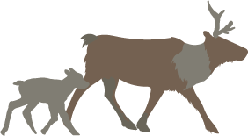
Revelstoke Complex and Central Selkirks Caribou Recovery Planning Options
January 23rd, 2023

Slide 2
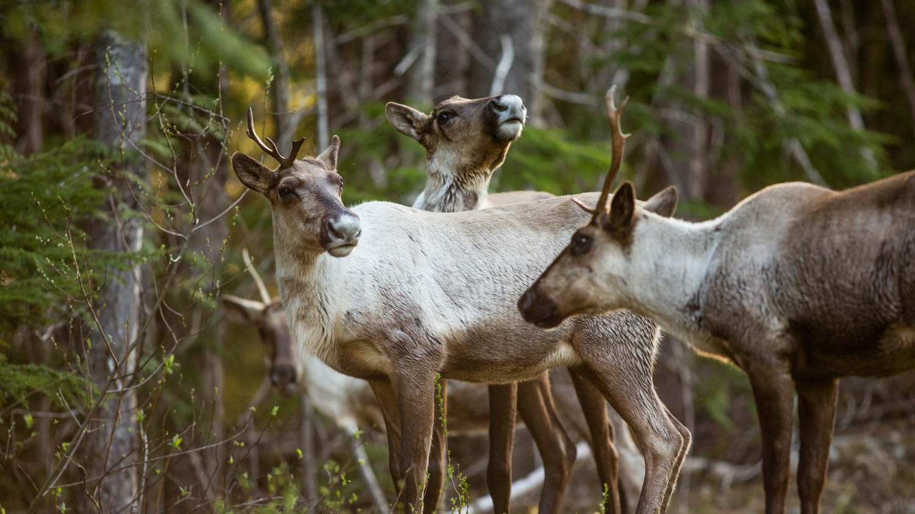
The Ultimate Goal
To produce a unified, evidence-based, and “caribou-first” recovery plan statement.
To be provided to the province, forestry tenure holders, stakeholders and the public
Moskowitz 2018
Notes:
will look at suggestions to explore making Core and Matrix slides, clearer, the current state, and Pros/cons for caribou for each option. Risks/costs for each option. federal process/threshold.

Slide 3
Involved parties
Indigenous communities
Splatsin
Okanagan Nation Alliance
Adams Lake
Shuswap
Ktunaxa
Okanagan Indian Band
Simpcw
Little Shuswap Lake
Provincial
BC Caribou Recovery Team
Ministry of Forests
  District Regional and old growth Resource Management
  First Nation relations
Federal
Environment Climate Change Canada – Canadian Wildlife Service

Slide 4
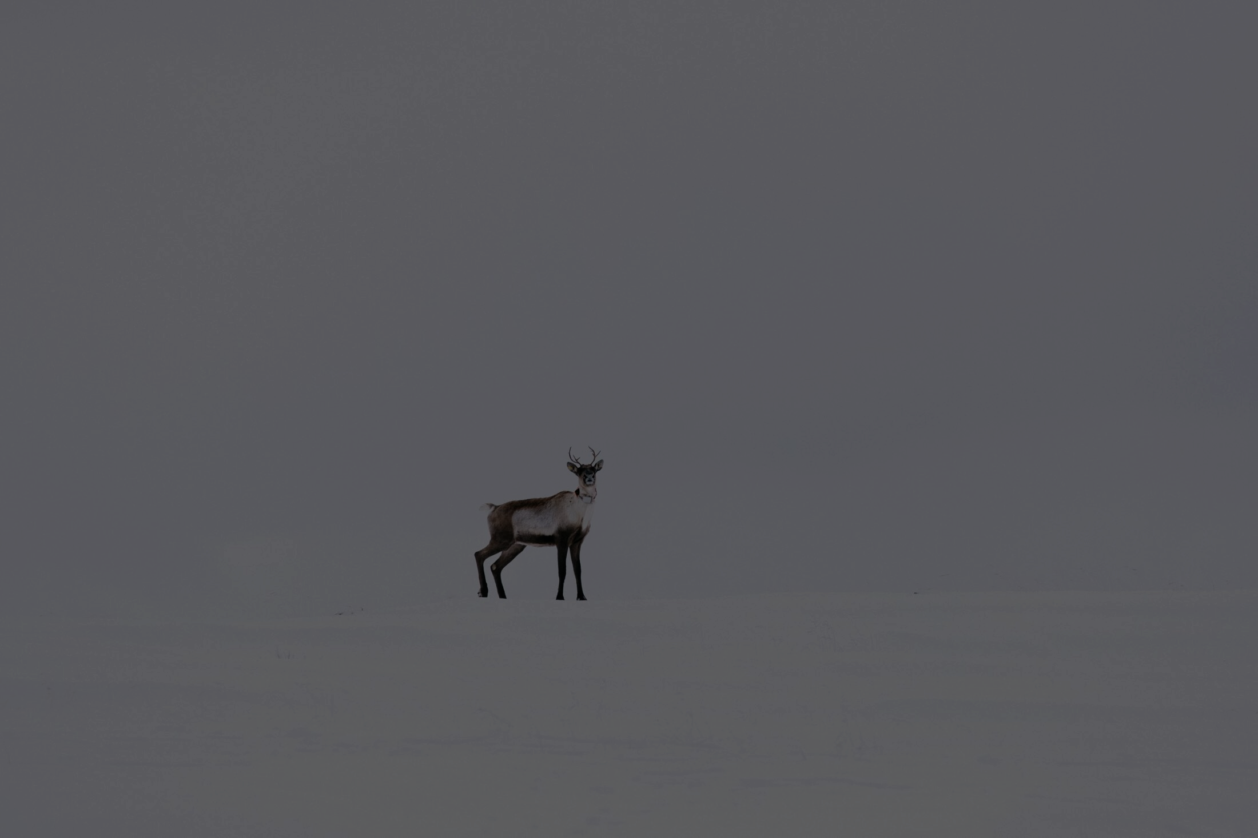
What is new?
1. New Long-Term Options
2. Considerations of Socioeconomic Costs & Opportunities
3. Leveraging Experts and Case-Studies
PC: Jeremy Koreski

Slide 5
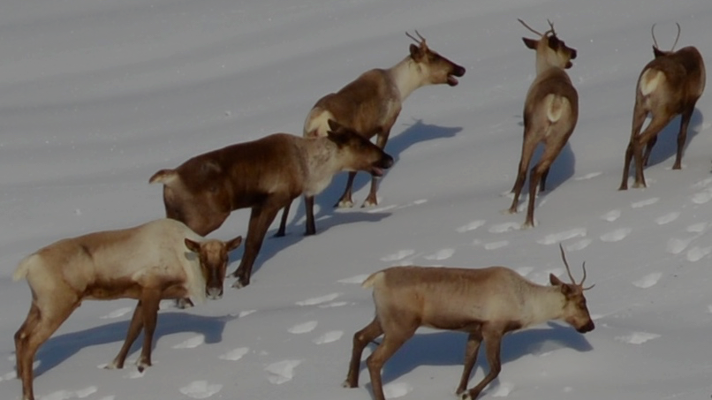
Setting and Understanding Objectives
Robert Berdan

Slide 6
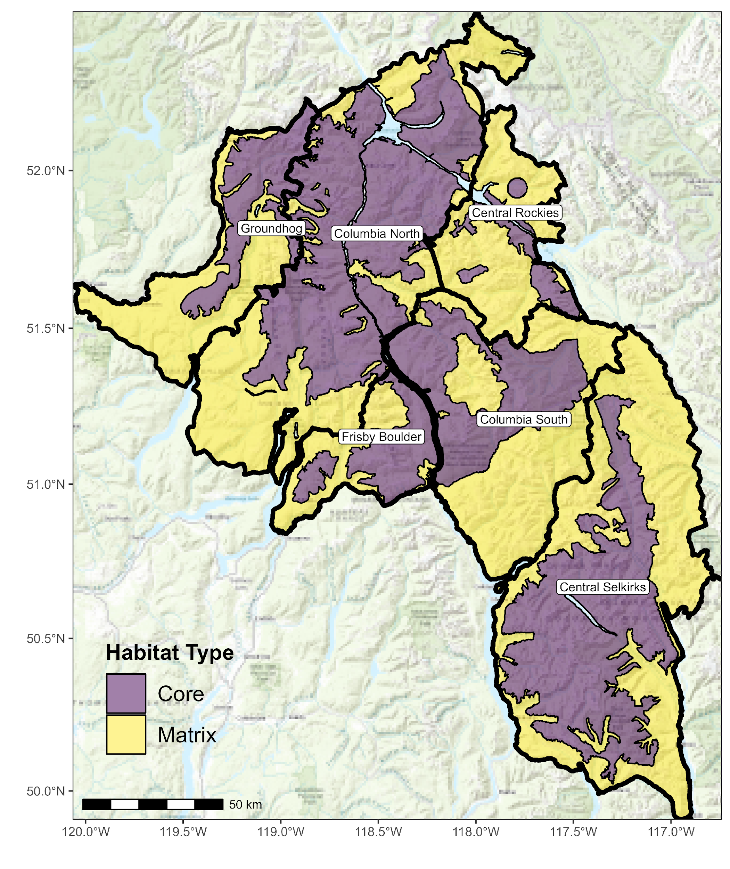
Core vs. Matrix
Core: Used directly by caribou – necessary habitat for survival
Matrix: not directly used by caribou, but still very important. The concern is disturbing matrix habitat will produce more
moose and wolves. Thus, Matrix habitat is still very important to recovering caribou.

Slide 7
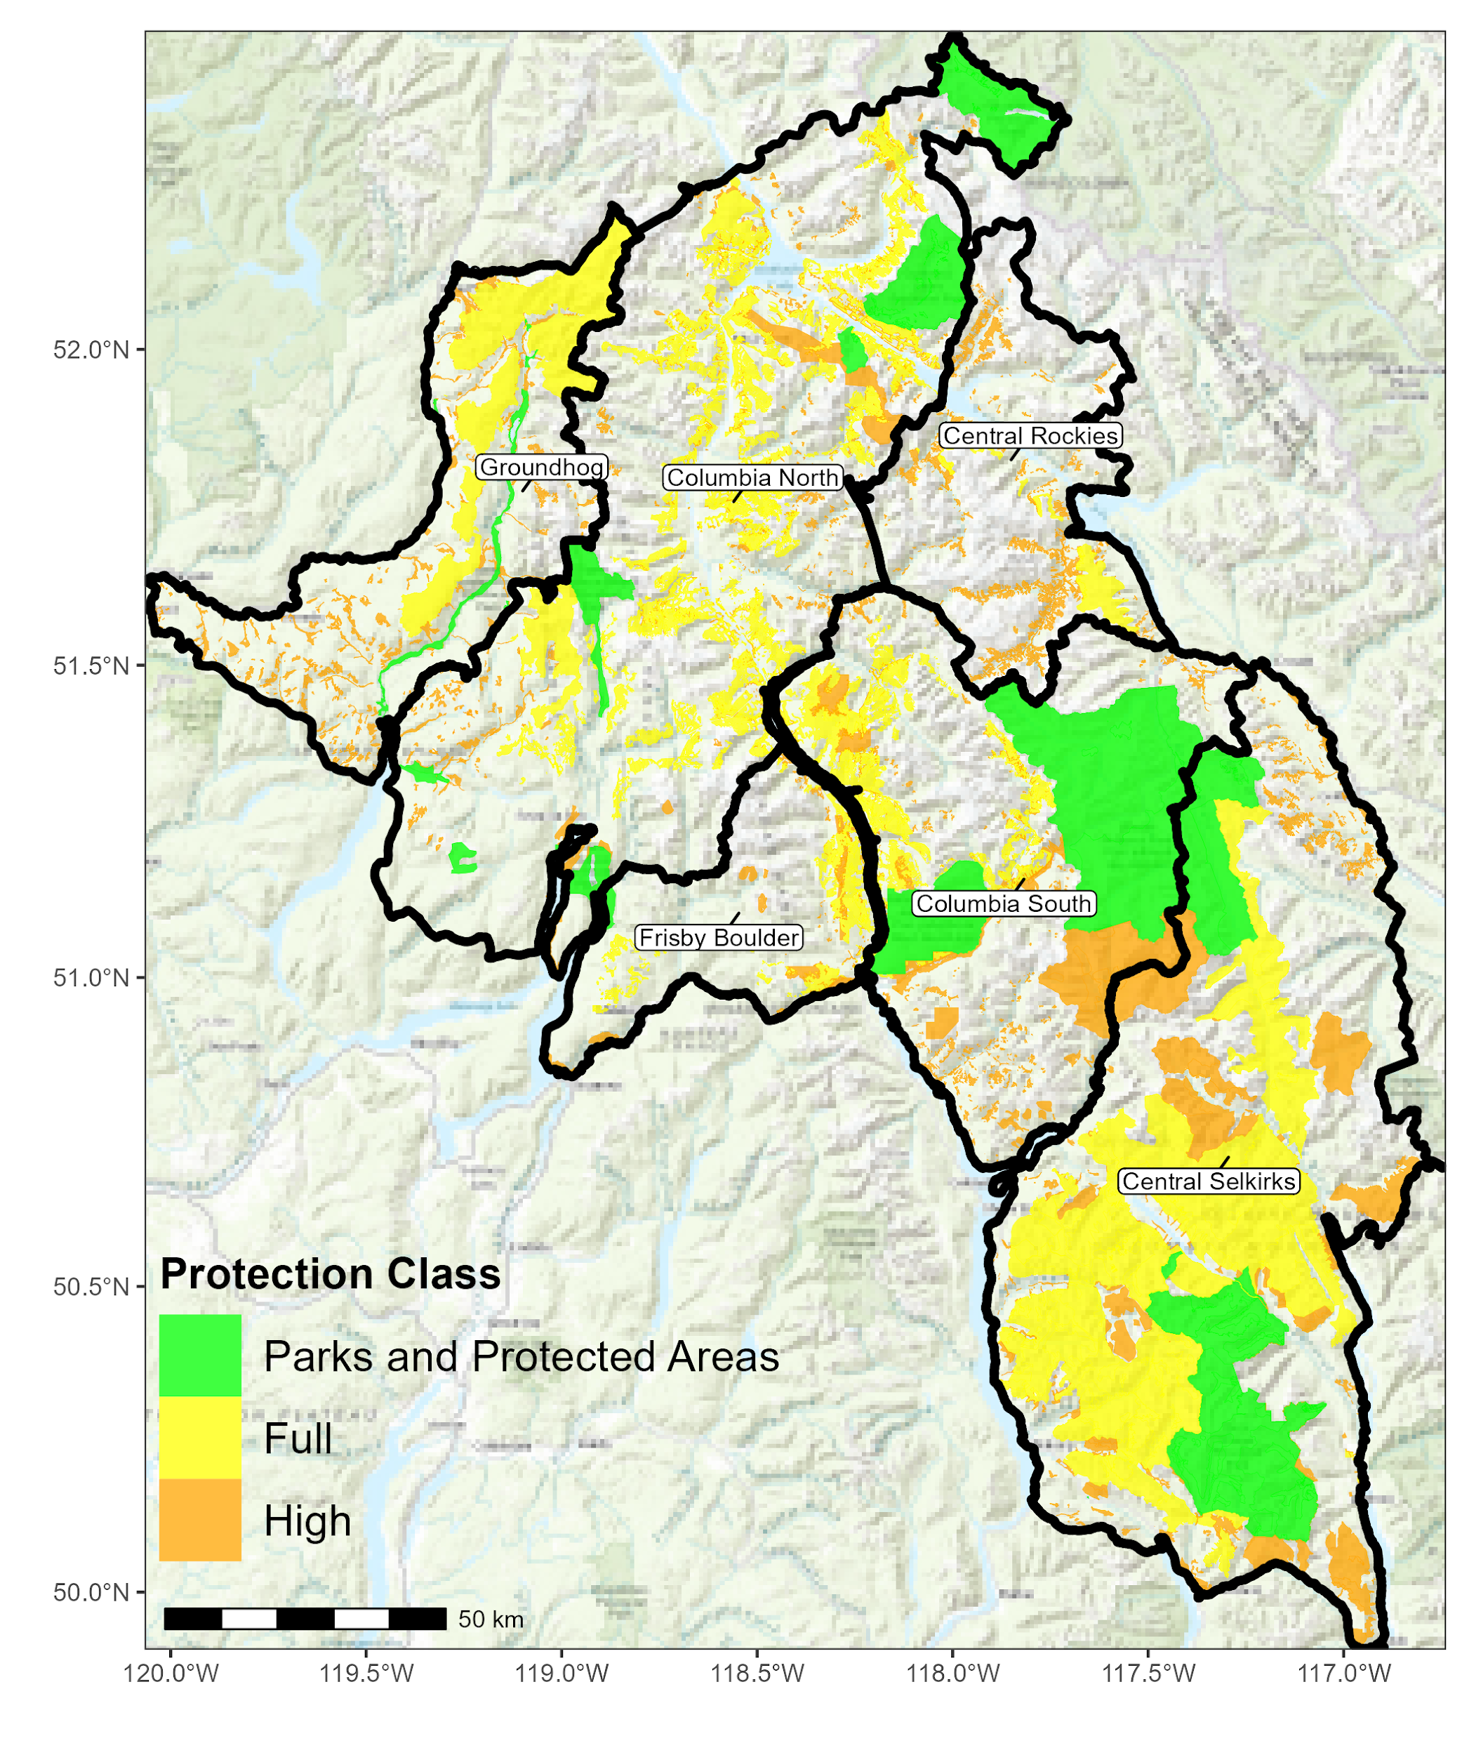
Existing Habitat Protections
Parks and Protected Areas: National Park, Provincial Park, highest level of protection
Full: No forestry permitted, for example Ungulate Winter Range (GAR)
High: 98% protection, tiny bit of harvest may bleed into these areas but only 2% incursion. Example: Old Growth Management Areas
Notes:
Full = eg., ungulate winter range – no forestry permitted. Not all GARS are included. ALL yellow is no harvest.
High = as an example Old Growth Management Areas. National wildlife areas. Tiny bit of harvest in High – good example is in OGMA’s. Allowed a 2% incursion – under strict designations.

Slide 8
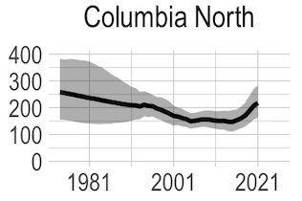
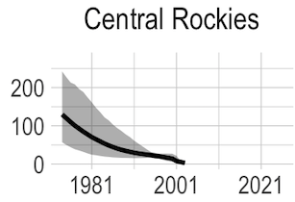
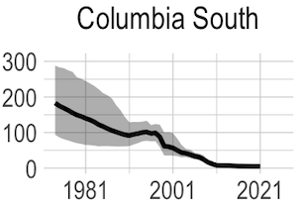
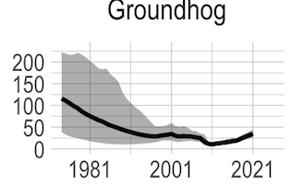
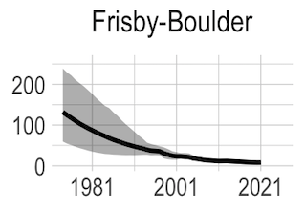
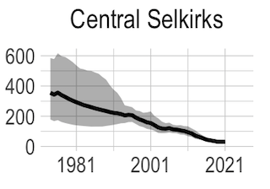
n=212 (2021)
n=14 (2000)
n= 1 (2022)
n=35 (2021)
n=30 (2021)
n=10 (2021)
Ernst 2022 & Lamb et al. 2023
Notes:
Paste on numbers
Original Core Matrix – based on 2014 federal federal species at risk delientation of core and matrix – in 2017 it was further refined by the Province Rob et al.
Middle of Kinbasket – JUST A spatial thing – does not take into account nuances in caribou habitat. Gives zero consideration to what habitat really is.

Slide 9
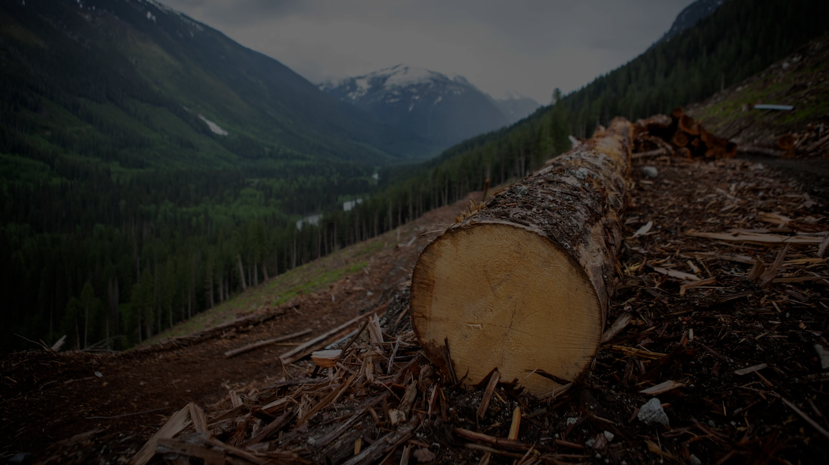
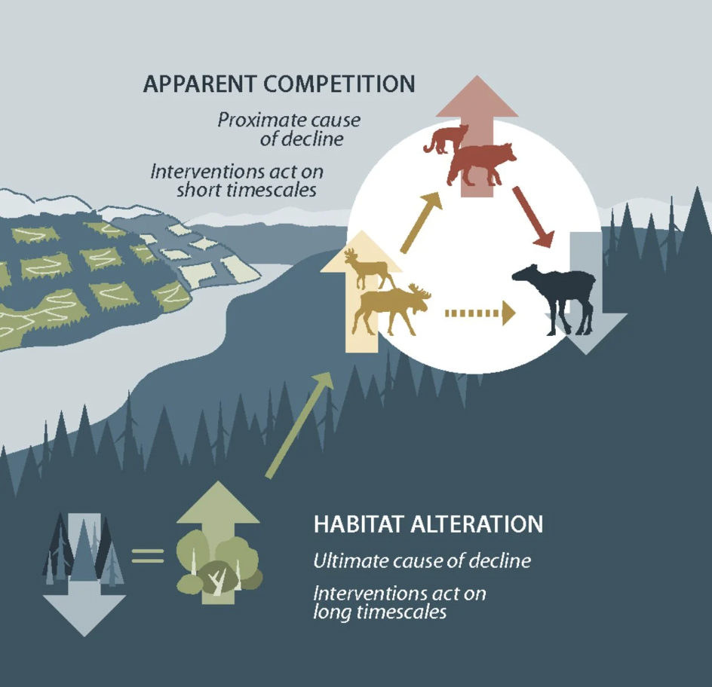
How we got here
Serrouya et al. 2019
Vernett & Kulkarni 2022 - CBC

Slide 10
Old
(1) Self Sustaining
(2) Self Sustaining with Assistance
Forest Age
Caribou Sustained
(3) Maintain with Intervention
Caribou Extinction
Young
Ground
Aerial
Predator Hunting
Notes:
Emhpasize black dot lots of intervention
Kathi — minimum options to recover caribou
Self sustaining – we agree on full protection of core – and matrix natural seral state
SSWA – we don’t know yet – with Kernal – using decision tree – incremental
Borrow language from Dave’s email.
Option 1 – full protection of core – natural forest state for matrix – allow some logging in the matrix
Option 2 – Self sustaining with assistance – prioritize habitat - don’t point to the Uds – put a few dots
- Uds matter in where to put habitat protection

Slide 11
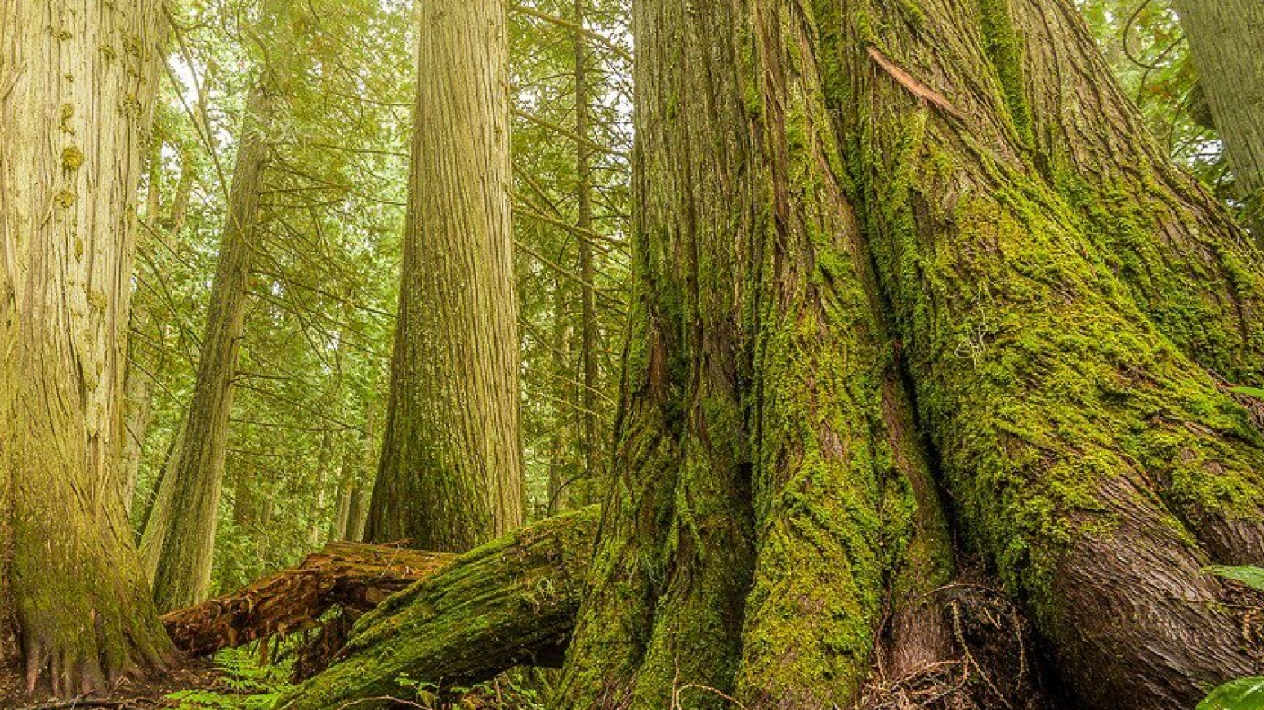
Self Sustaining
Restoring and maintaining habitat conditions that allow mountain caribou populations within planning units to withstand random events and other environmental variables without the need for long-term, predator-prey management

Slide 12
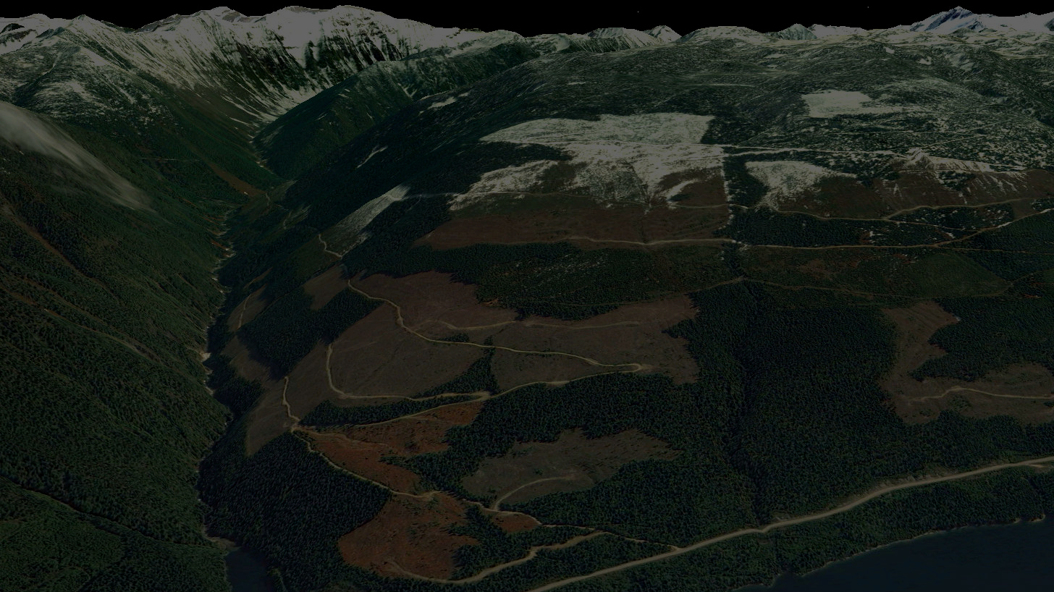
Self Sustaining with Assistance
Strategies applied in sufficient intensity and duration to achieve a population able to withstand random events and other environmental variables with ongoing habitat management and protection, management of backcountry recreation and relatively low but sustainable populations of specific caribou predators and their primary prey. Planning unit populations are sufficiently large and widespread to ensure regular exchange of animals with other planning units (i.e., a functioning metapopulation).
Laforme Creek, North of Revelstoke
Notes:
This is a picture of LaForme creek which is in the northern end of the study area.

Slide 13
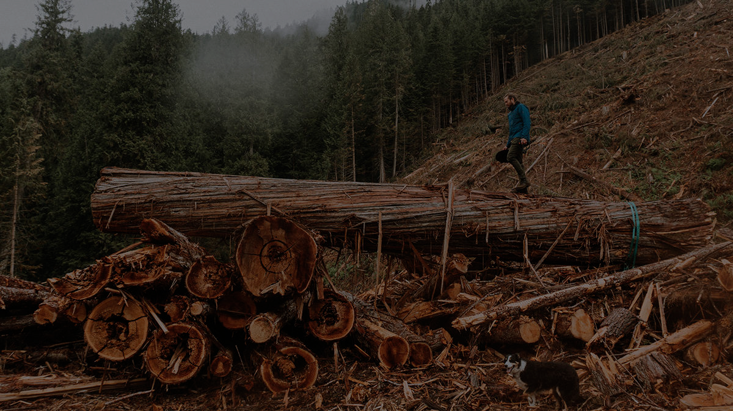
Maintain with Intervention
Maintain or increase a planning unit population to 75-100 animals. The goal would be to maintain populations at least at their current levels or, where necessary, to increase them to 75-100 animals. Note that due to this small size, a subpopulation will likely decline to where it 1) is highly vulnerable before appropriate management actions are developed and applied. As a result, management will likely need to be aggressive at times.

Slide 14
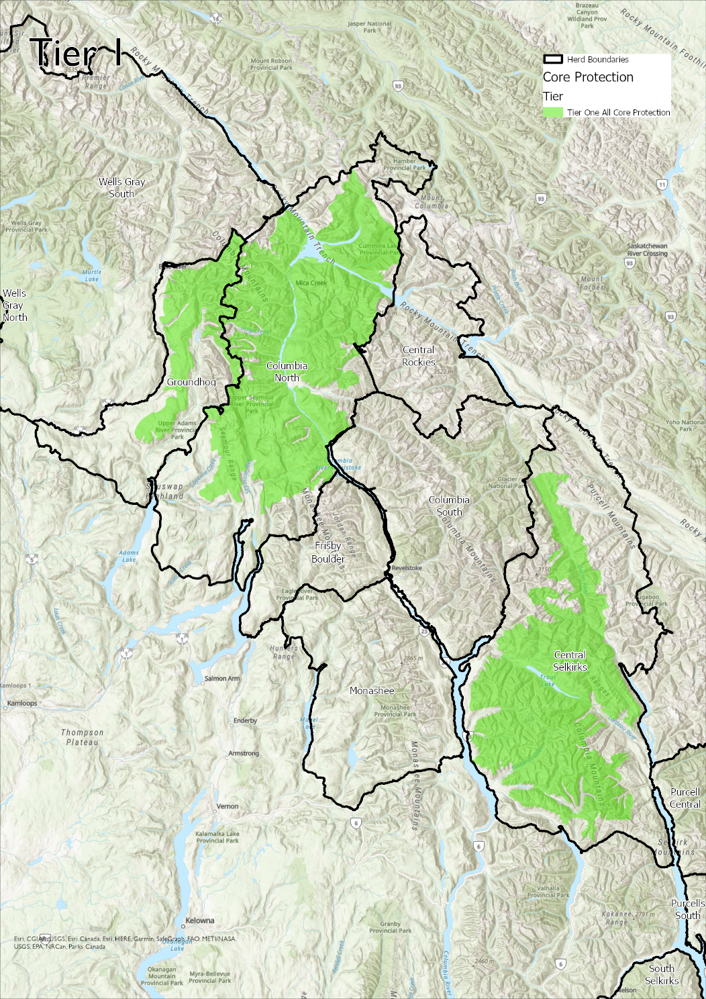
Tier #1 (Self Sustaining)
Protecting all core that isn’t already protected
Manage all matrix to a natural forest state
Notes:
Reference back to what is already protected
**Darcy – phrasing to options can introduce decision makers focusing on lowest option. Suggest to balance…. Protect core, manage matrix in a way that we don’t need to keep killing wolves.
** lay out the realities of caribou conservstation. Have a new slide -
Summarize as best available options we have agreed upon
ALL the options are intended to allow for recovery

Slide 15
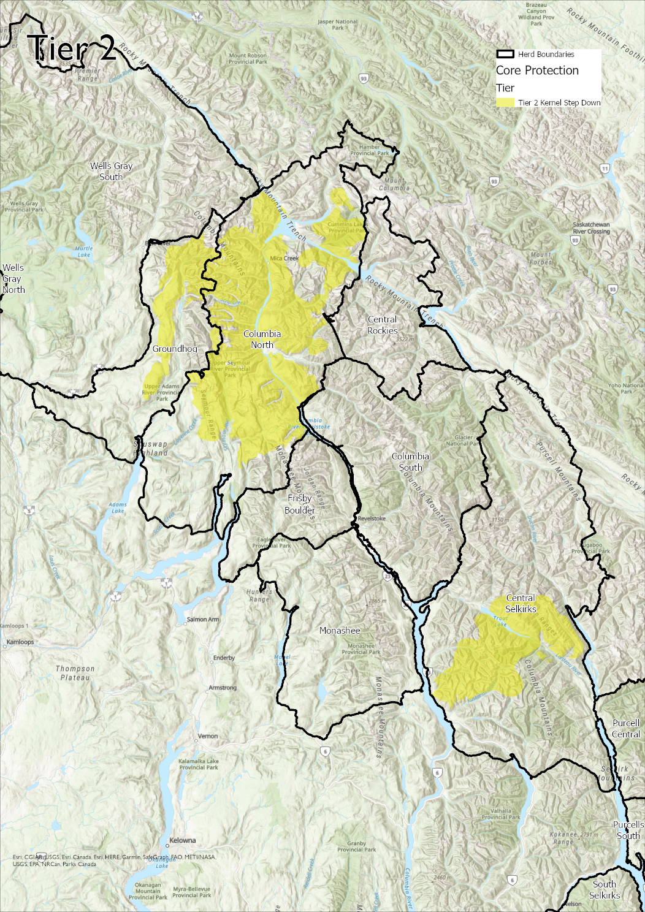
Tier #2 (Self Sustaining with Assistance)
Protect 95% Utilized Distribution within Core (Central Selkirks, Columbia North
Protect 90% Utilized Distribution for Groundhog within Core
Maintain existing protections for non-priority populations
Matrix scenarios under review
Notes:
Steps down
Frisby, CS, CR - Not off table just status quo

Slide 16
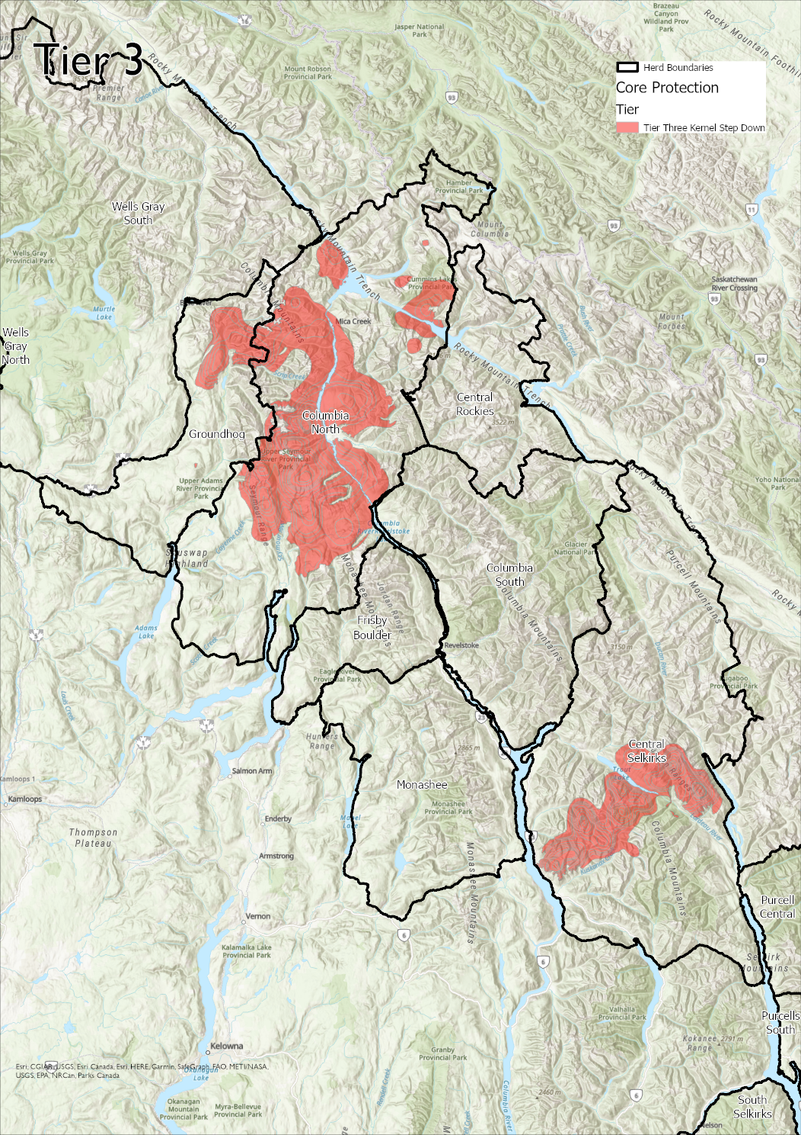
Tier #3 (Self Sustaining with Intervention)
90% UD’s for Columbia North and Groundhog
80% UD’s for Groundhog
Matrix scenarios under review
Notes:
Minimum amount to be expected for recovery
1 kernel threshold for value of high. Everything not within 98% kernel was downgraded.
Kernal was used as apiroiruty area

Slide 17
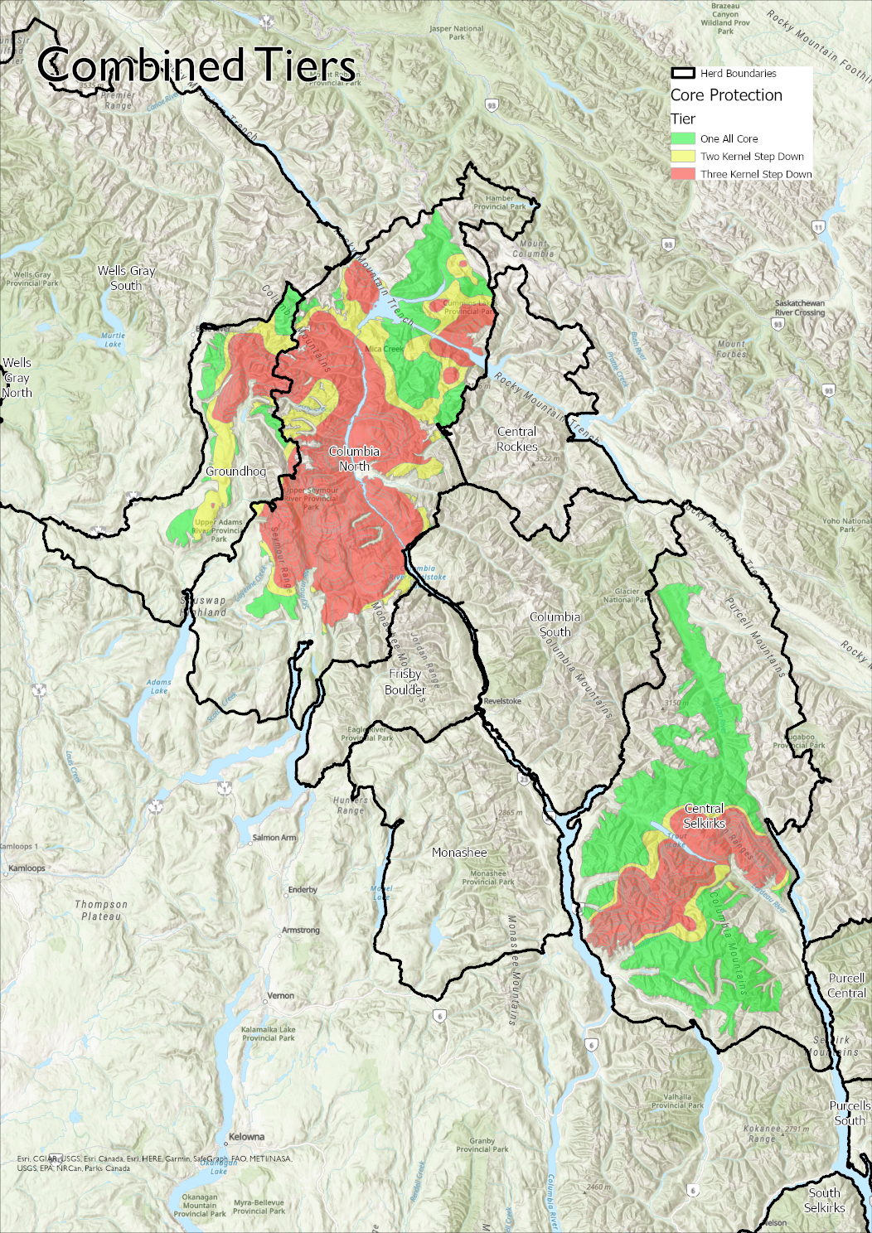

Slide 18
Existing Habitat Protections
Parks and Protected Areas: National Park, Provincial Park, highest level of protection
Full: No forestry permitted, for example Ungulate Winter Range (GAR)
High: 98% protection, tiny bit of harvest may bleed into these areas but only 2% incursion. Example: Old Growth Management Areas
Notes:
Full = eg., ungulate winter range – no forestry permitted. Not all GARS are included. ALL yellow is no harvest.
High = as an example Old Growth Management Areas. National wildlife areas. Tiny bit of harvest in High – good example is in OGMA’s. Allowed a 2% incursion – under strict designations.

Slide 19
Socioeconomics
Vernett & Kulkarni 2022 - CBC

Slide 20

Questions/Discussion

Slide 21
Discussion Points
Thoughts on long-term options?
Matrix management discussion
Tradeoffs between predator management and logging

Slide 22
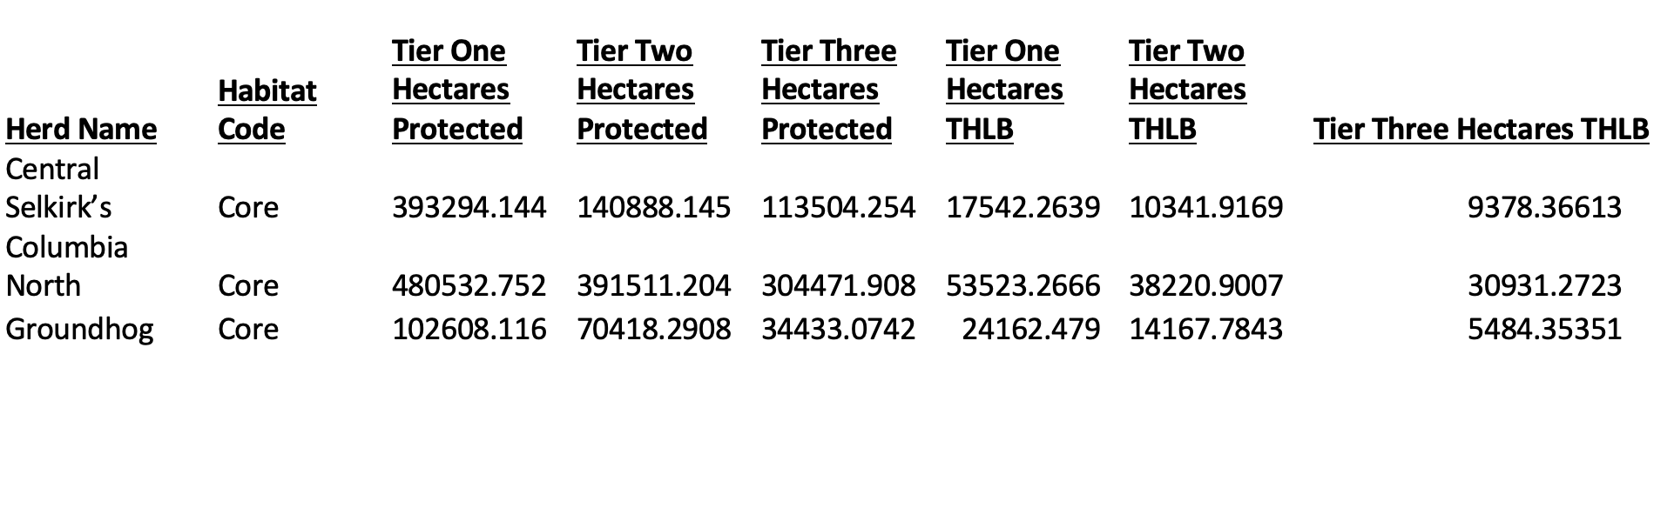

Slide 23
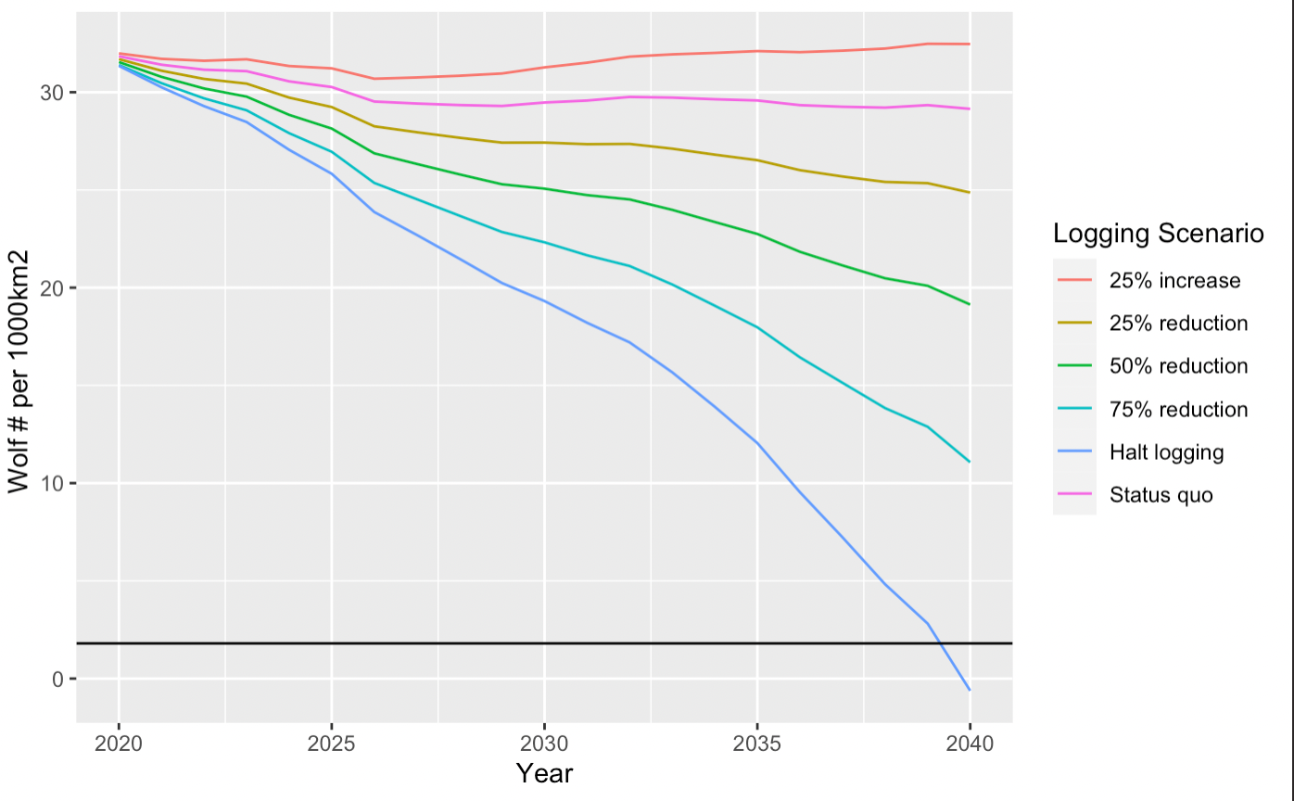
Future scenarios of wolf density (Columbia North herd boundary)
Wolf densities 2022
610 hectares logged per year
Threshold of wolf density adequate for caribou recovery
Predicted year (2038) where wolf removals will no longer be needed due to an aging forest (and a “halt logging” scenario)
Notes:
In the year 2000 we were at about 50/1000km
Now, closer to 10/1000km2
Wolf population following the Messier wolf-moose conversion equation projected from 2020-2040 based on habitat based (K=carrying capacity) moose population simulation where no moose reduction or stabilization harvest regime was enacted.

Slide 24
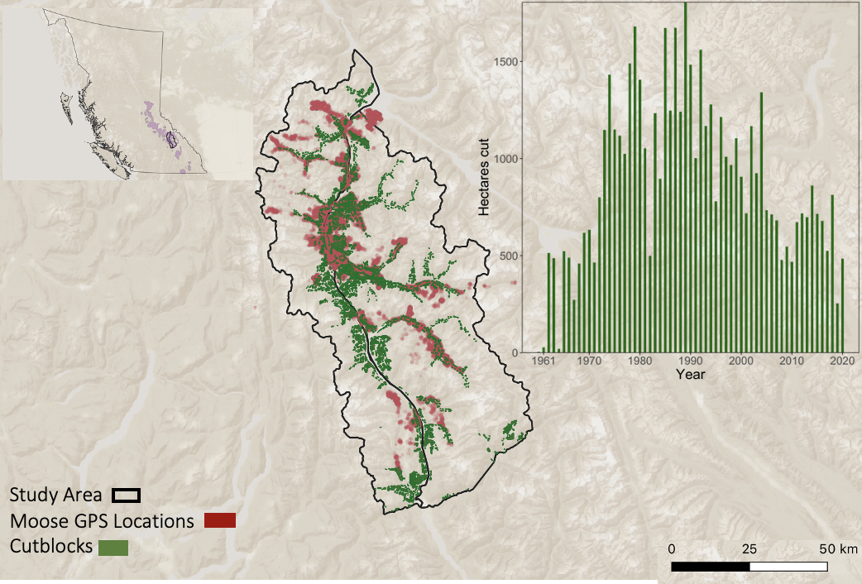

Slide 25
*End – things below are from previous meetings (27Jan2023 – Mateen)

Slide 31
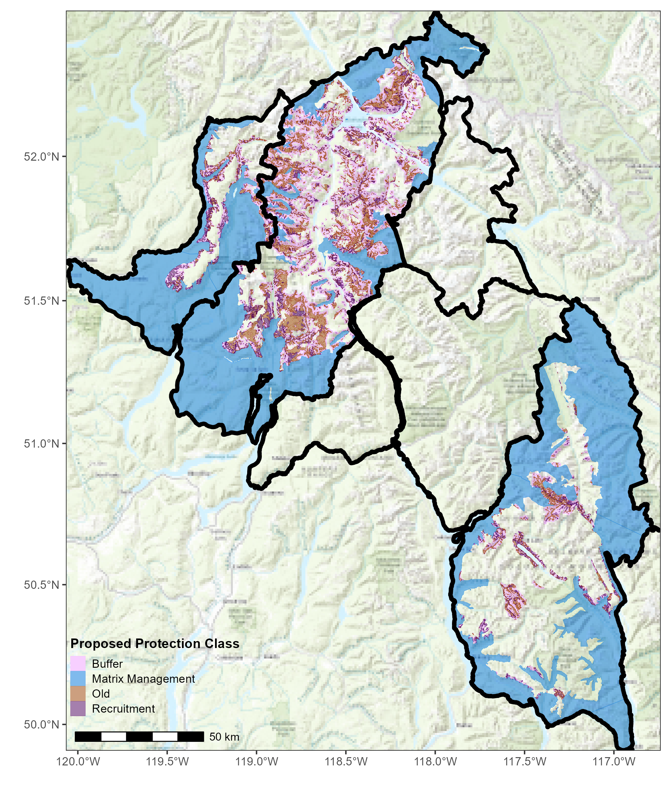
Proposed Protection Class
Notes:
**Extending the CAP to other herd boundaries

Slide 32
Definitions
Mature Forest: > 100 years old
Recruitment Forest: >80 years old
THLB: Timber Harvesting Land Base
Core caribou habitat: Used directly by caribou – necessary habitat for survival
Matrix caribou habitat: not directly used by caribou, but still very important
Kernel Density: heat map of animals
Buffer: added area or distance from point (e.g., 500m)
GAR: Government Action Regulation – also known as “Ungulate Winter Range” protections
Notes:
ALL GARs are not Ungulate Winter Range – wildlife habitat areas under the GAR – research areas under the GAR – legistlation piece that allows Gov to exclude range or forestry from specific areas.

Slide 33
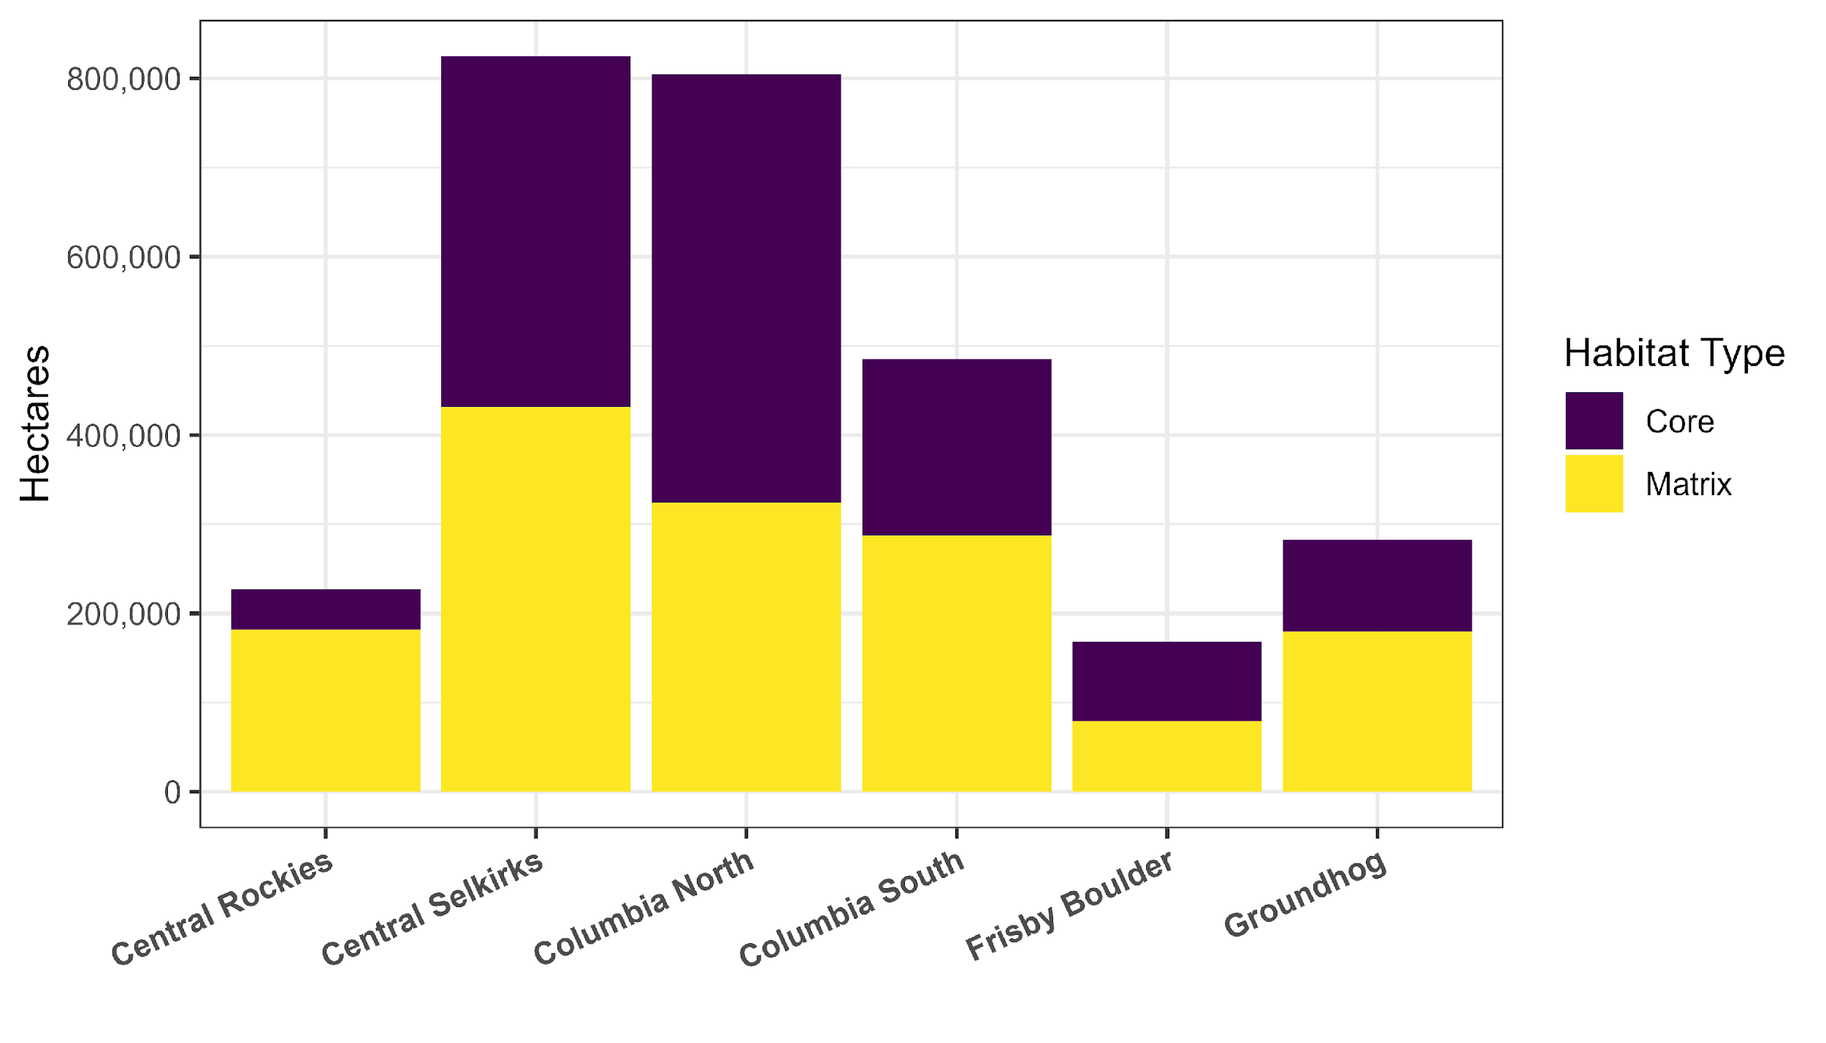
Breakdown of Core vs. Matrix

Slide 34
Existing Habitat Protections
Parks and Protected Areas: National Park, Provincial Park, highest level of protection
Full: No forestry permitted, for example Ungulate Winter Range (GAR)
High: 98% protection, tiny bit of harvest may bleed into these areas but only 2% incursion. Example: Old Growth Management Areas
Notes:
Full = eg., ungulate winter range – no forestry permitted. Not all GARS are included. ALL yellow is no harvest.
High = as an example Old Growth Management Areas. National wildlife areas. Tiny bit of harvest in High – good example is in OGMA’s. Allowed a 2% incursion – under strict designations.

Slide 35
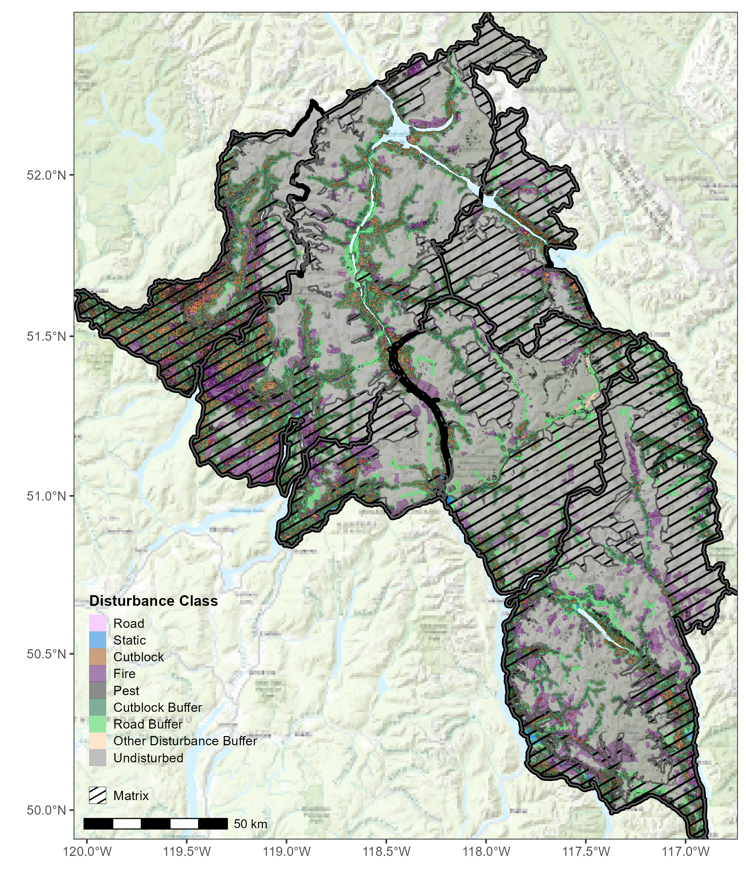
Current Disturbances
Road: All roads
Static: Permanent disturbance
Cutblock: logged area
Fire: burned area
Pest: e.g., pine beetle
Cutblock Buffer: 500m
Road Buffer: 25 meters
Other Disturbance Buffer: 500 meters
Undisturbed: not affected by any of the above disturbances

Slide 36
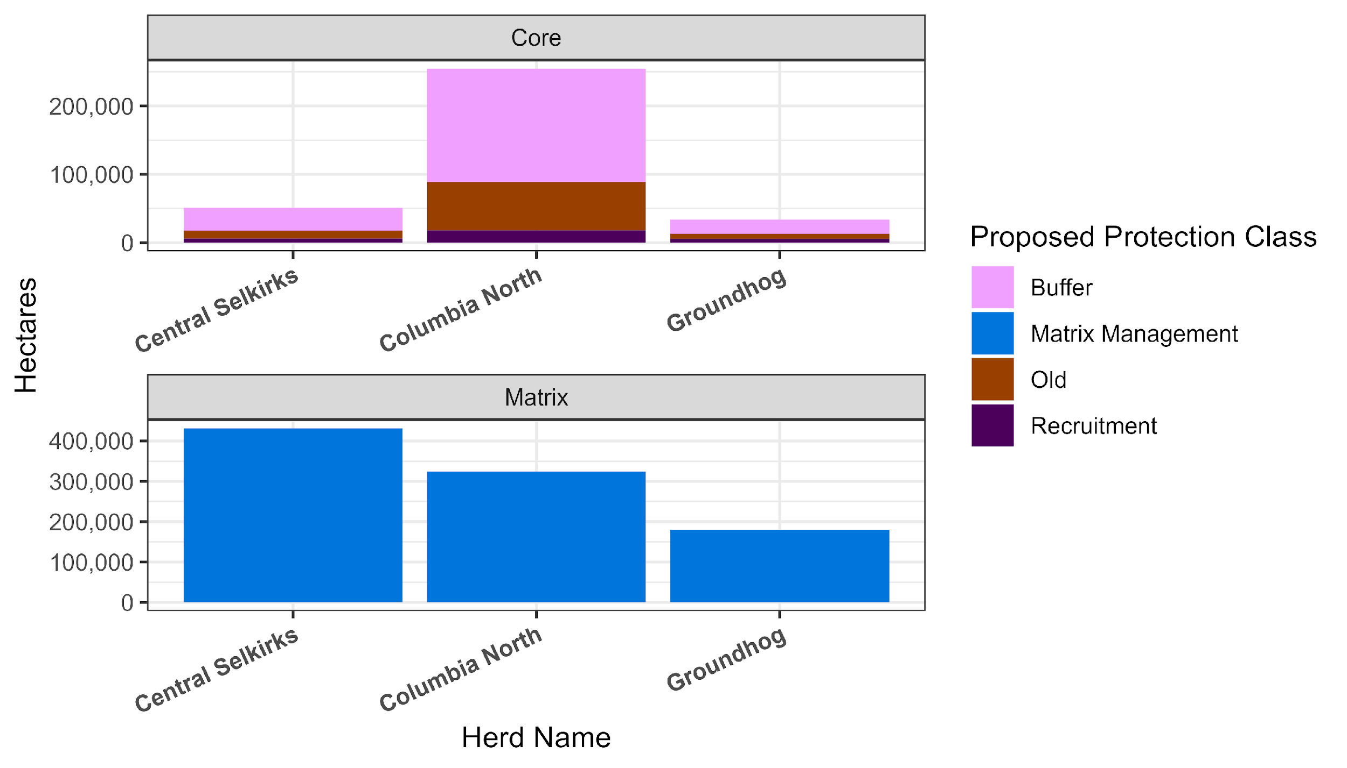
Proposed Protection Class – Core vs. Matrix
Notes:
Buffer bigger in CN because there is more habitat to bump into. If a buffer extends into a full habitat protection – it is not included.

Slide 37
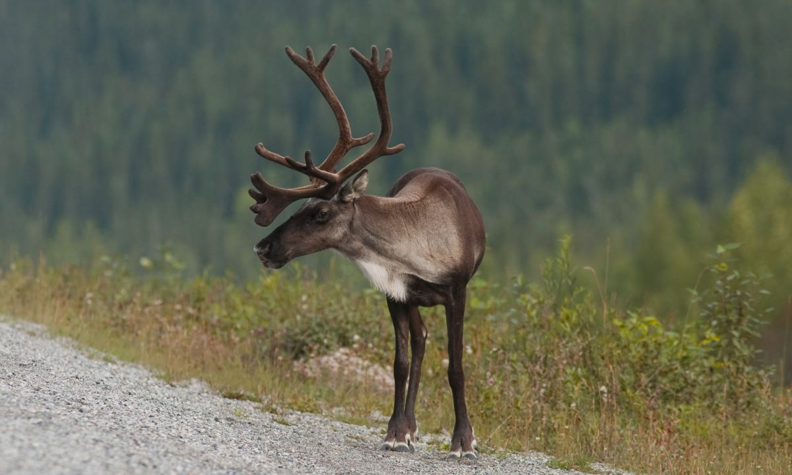
Options

Slide 38
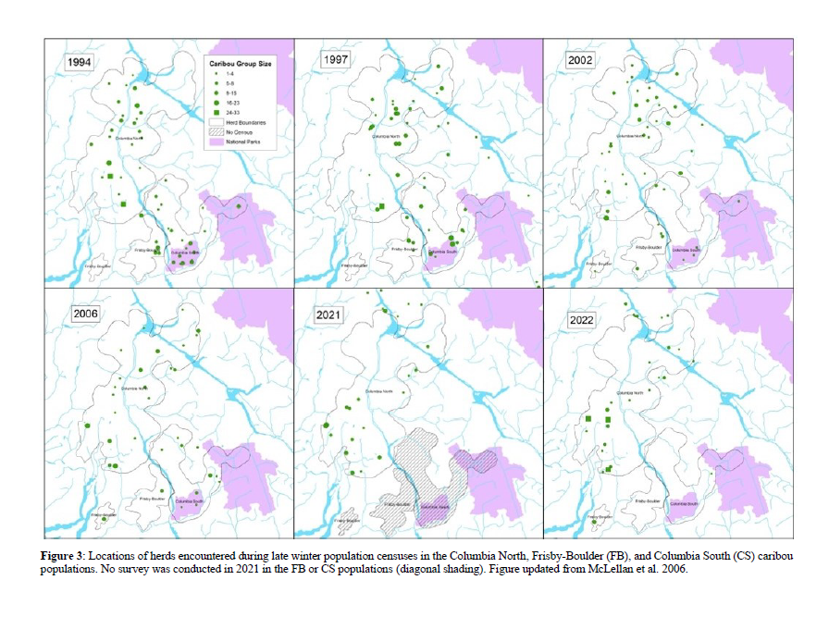
Caribou Locations (Columbia North, Columbia South, Firsby Boulder Queest)

Slide 39
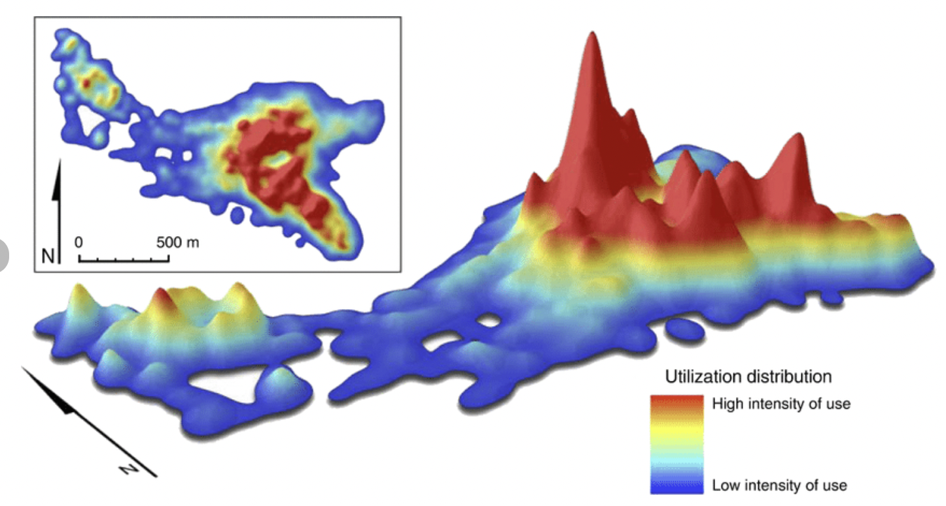
Kernel Density
Kernel Density: a tool used to define what areas animals spend the most amount of time in
Willems and Hill 2009

Slide 40
How options are defined
*Options are IN ADDITION to existing protections
Exclude disturbed habitat (<80 years old)
Include older forest (>100 years) & recruitment forest (>80-100 years old)
Exclude steep slopes (>70%)
Buffer 500 meters from what the old & recruitment
Assign priority classes (3 options) – either Kernel density or subject matter experts
  50, 75, 90 (high, medium, low)
Notes:
“undisturbed habitat” does not have anything listed as a disturbance – refer to Table 2.
70% - maximum slope for attainable THLB.
First four steps are the structure condition of the habitat
Steps 1-5 are just caribou habitat values
(6) Points – Nations can chime in on how these options are defined - partners may want to include different criteria at different steps — can add to it. *Intended to be a process.
old + recruitment forest stand with slopes greater than 70% were excluded as priority areas due to these areas being steeper than current operational feasibility for forestry
*flow chart or visual (entire habitat already protected, throw out protected, throw out what is already disturbed, throw out anything >70% — grab the old stuff of what is left – buffer out – separated by A, B, C — functionally grab 80 years and older (that is our starting point), not on super steep slopes.
Throwing out disturbed – we don’t want to waste protection capital on already disturbed landscapes – that 20 yo cutblock – we know that is a barrier we will run into.
500m buffer will include cutblocks + pests + if there is buffer inbetween them – still of value. We want to protect those inbetween areas. ”Armour Up.” Value of habitat patches diminishes if they are isolated – science based, include citation.

Slide 41
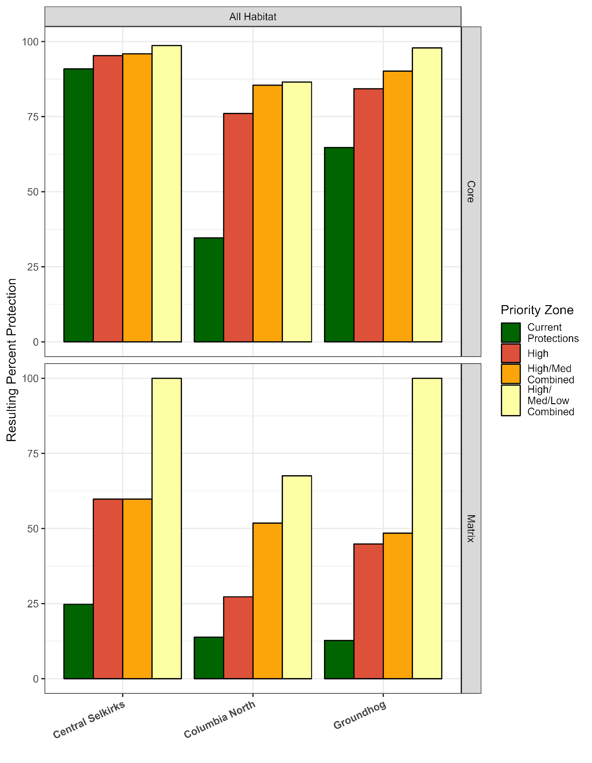
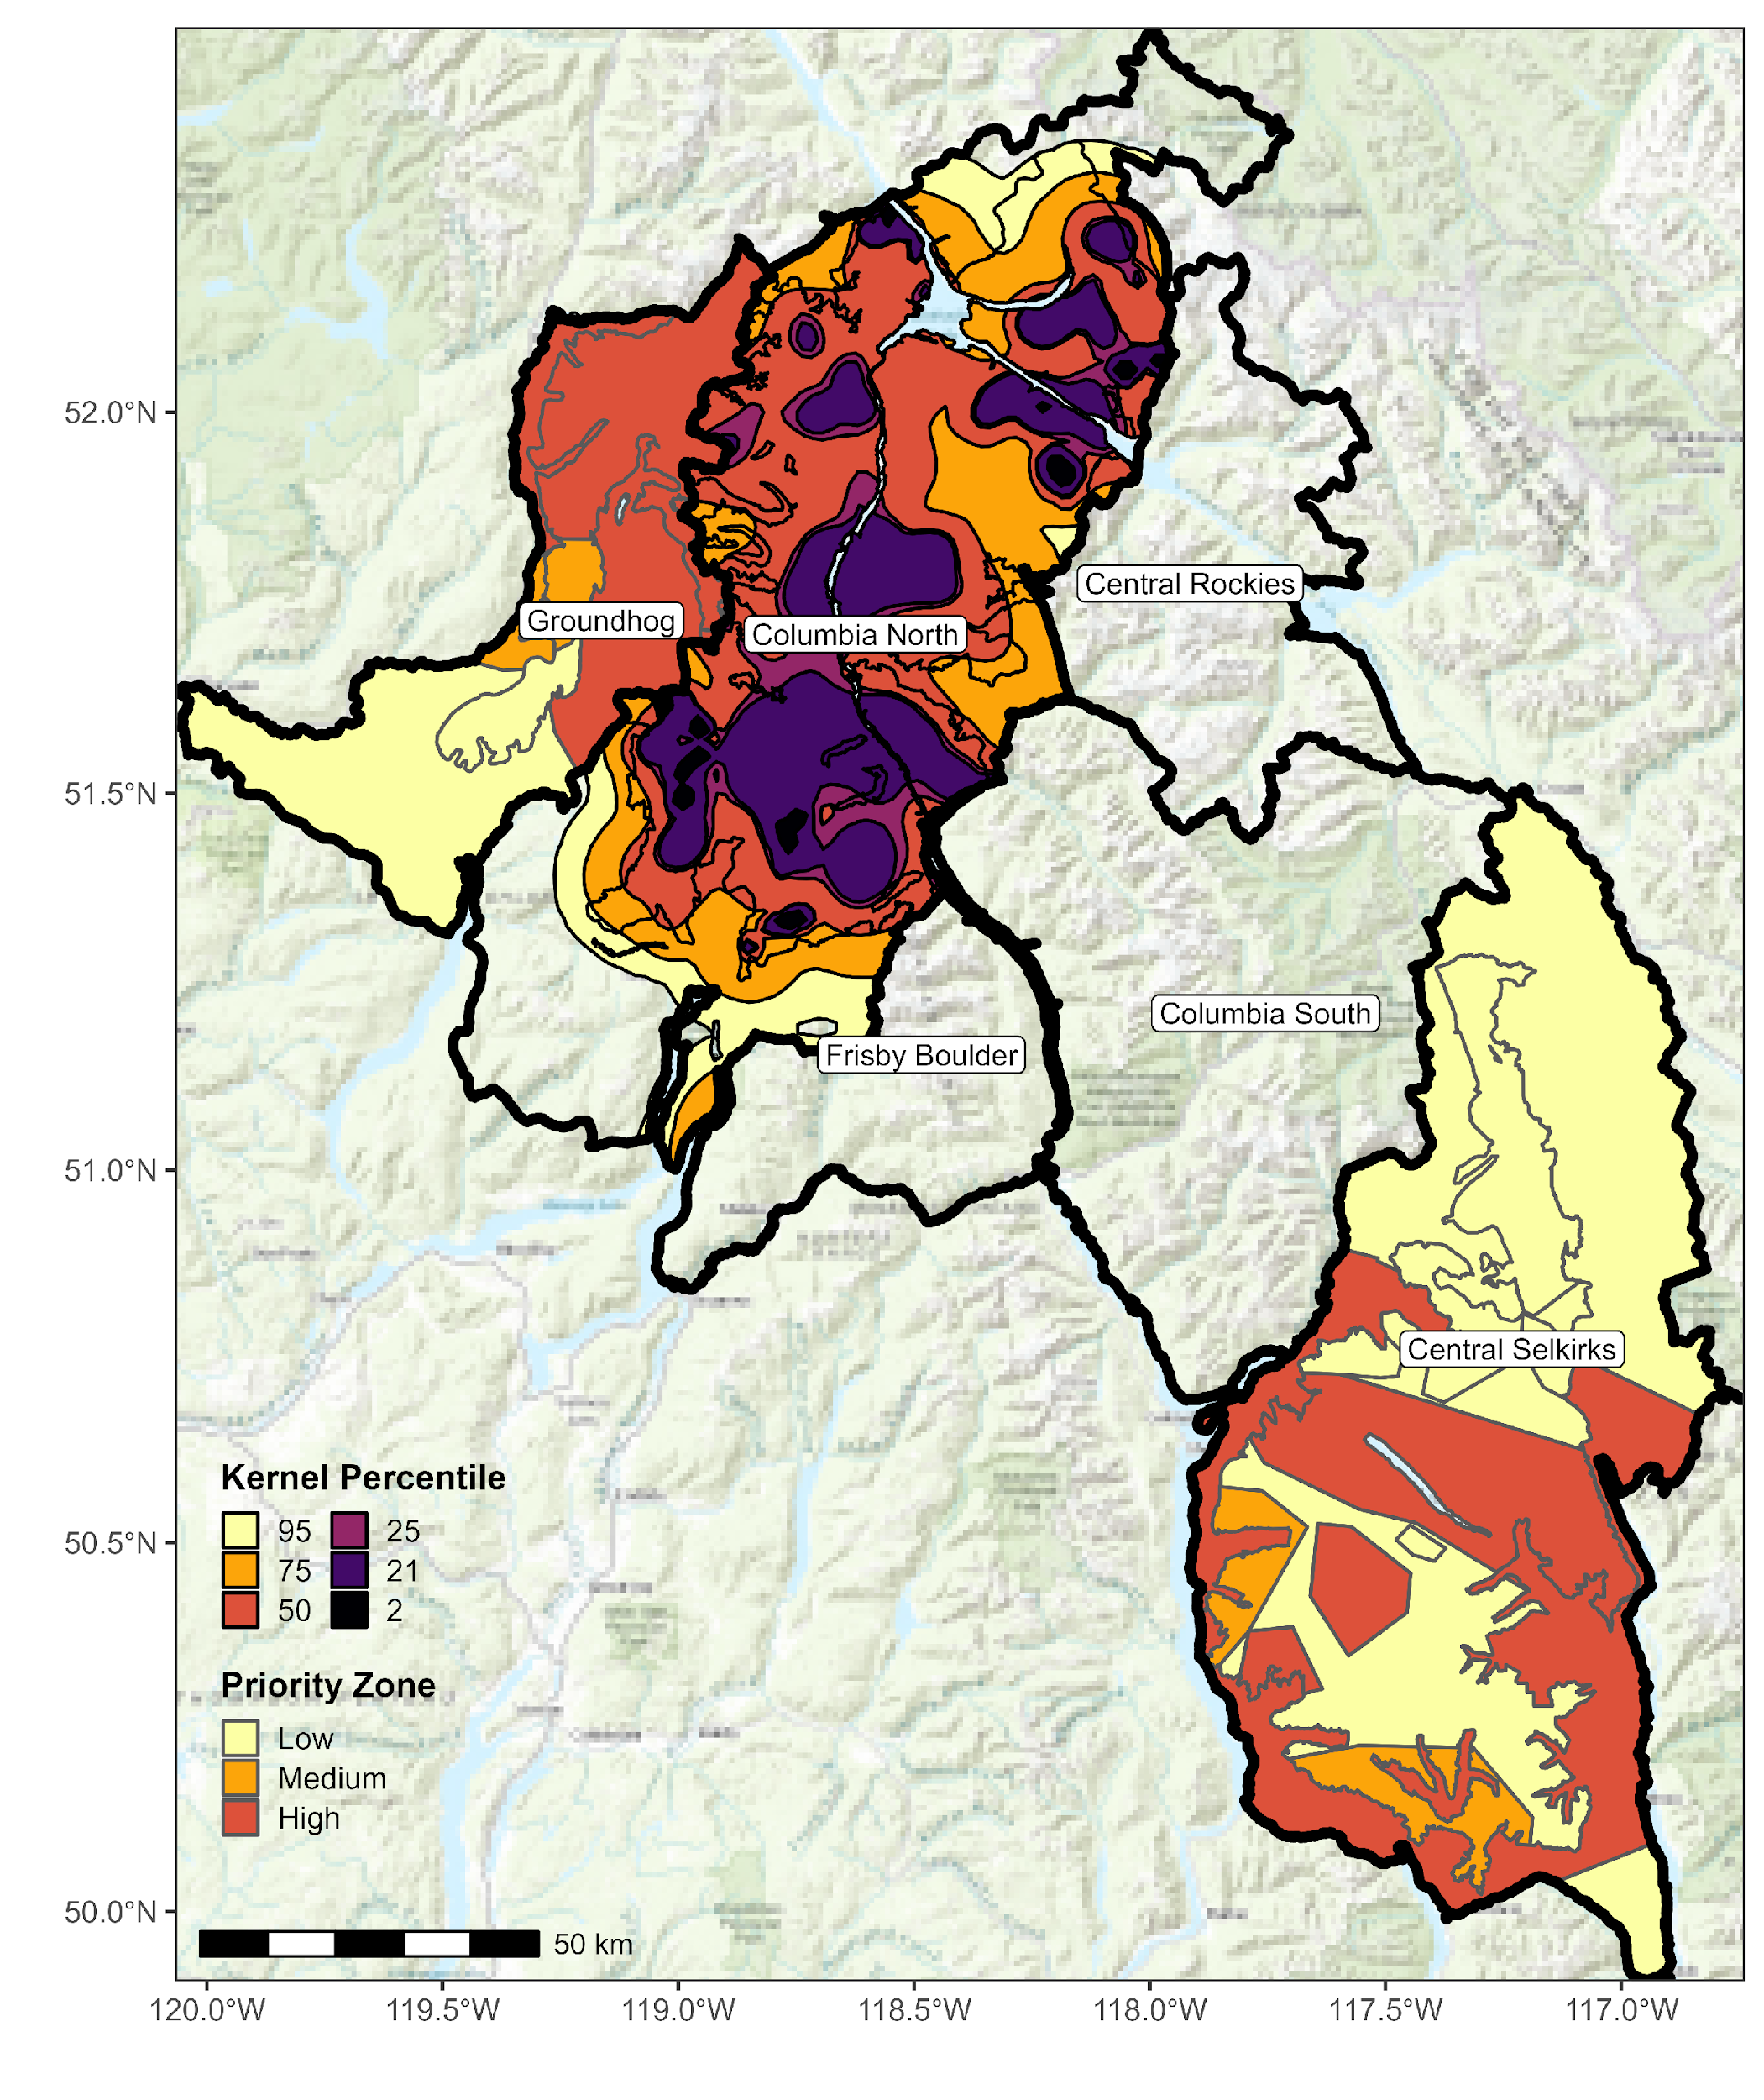
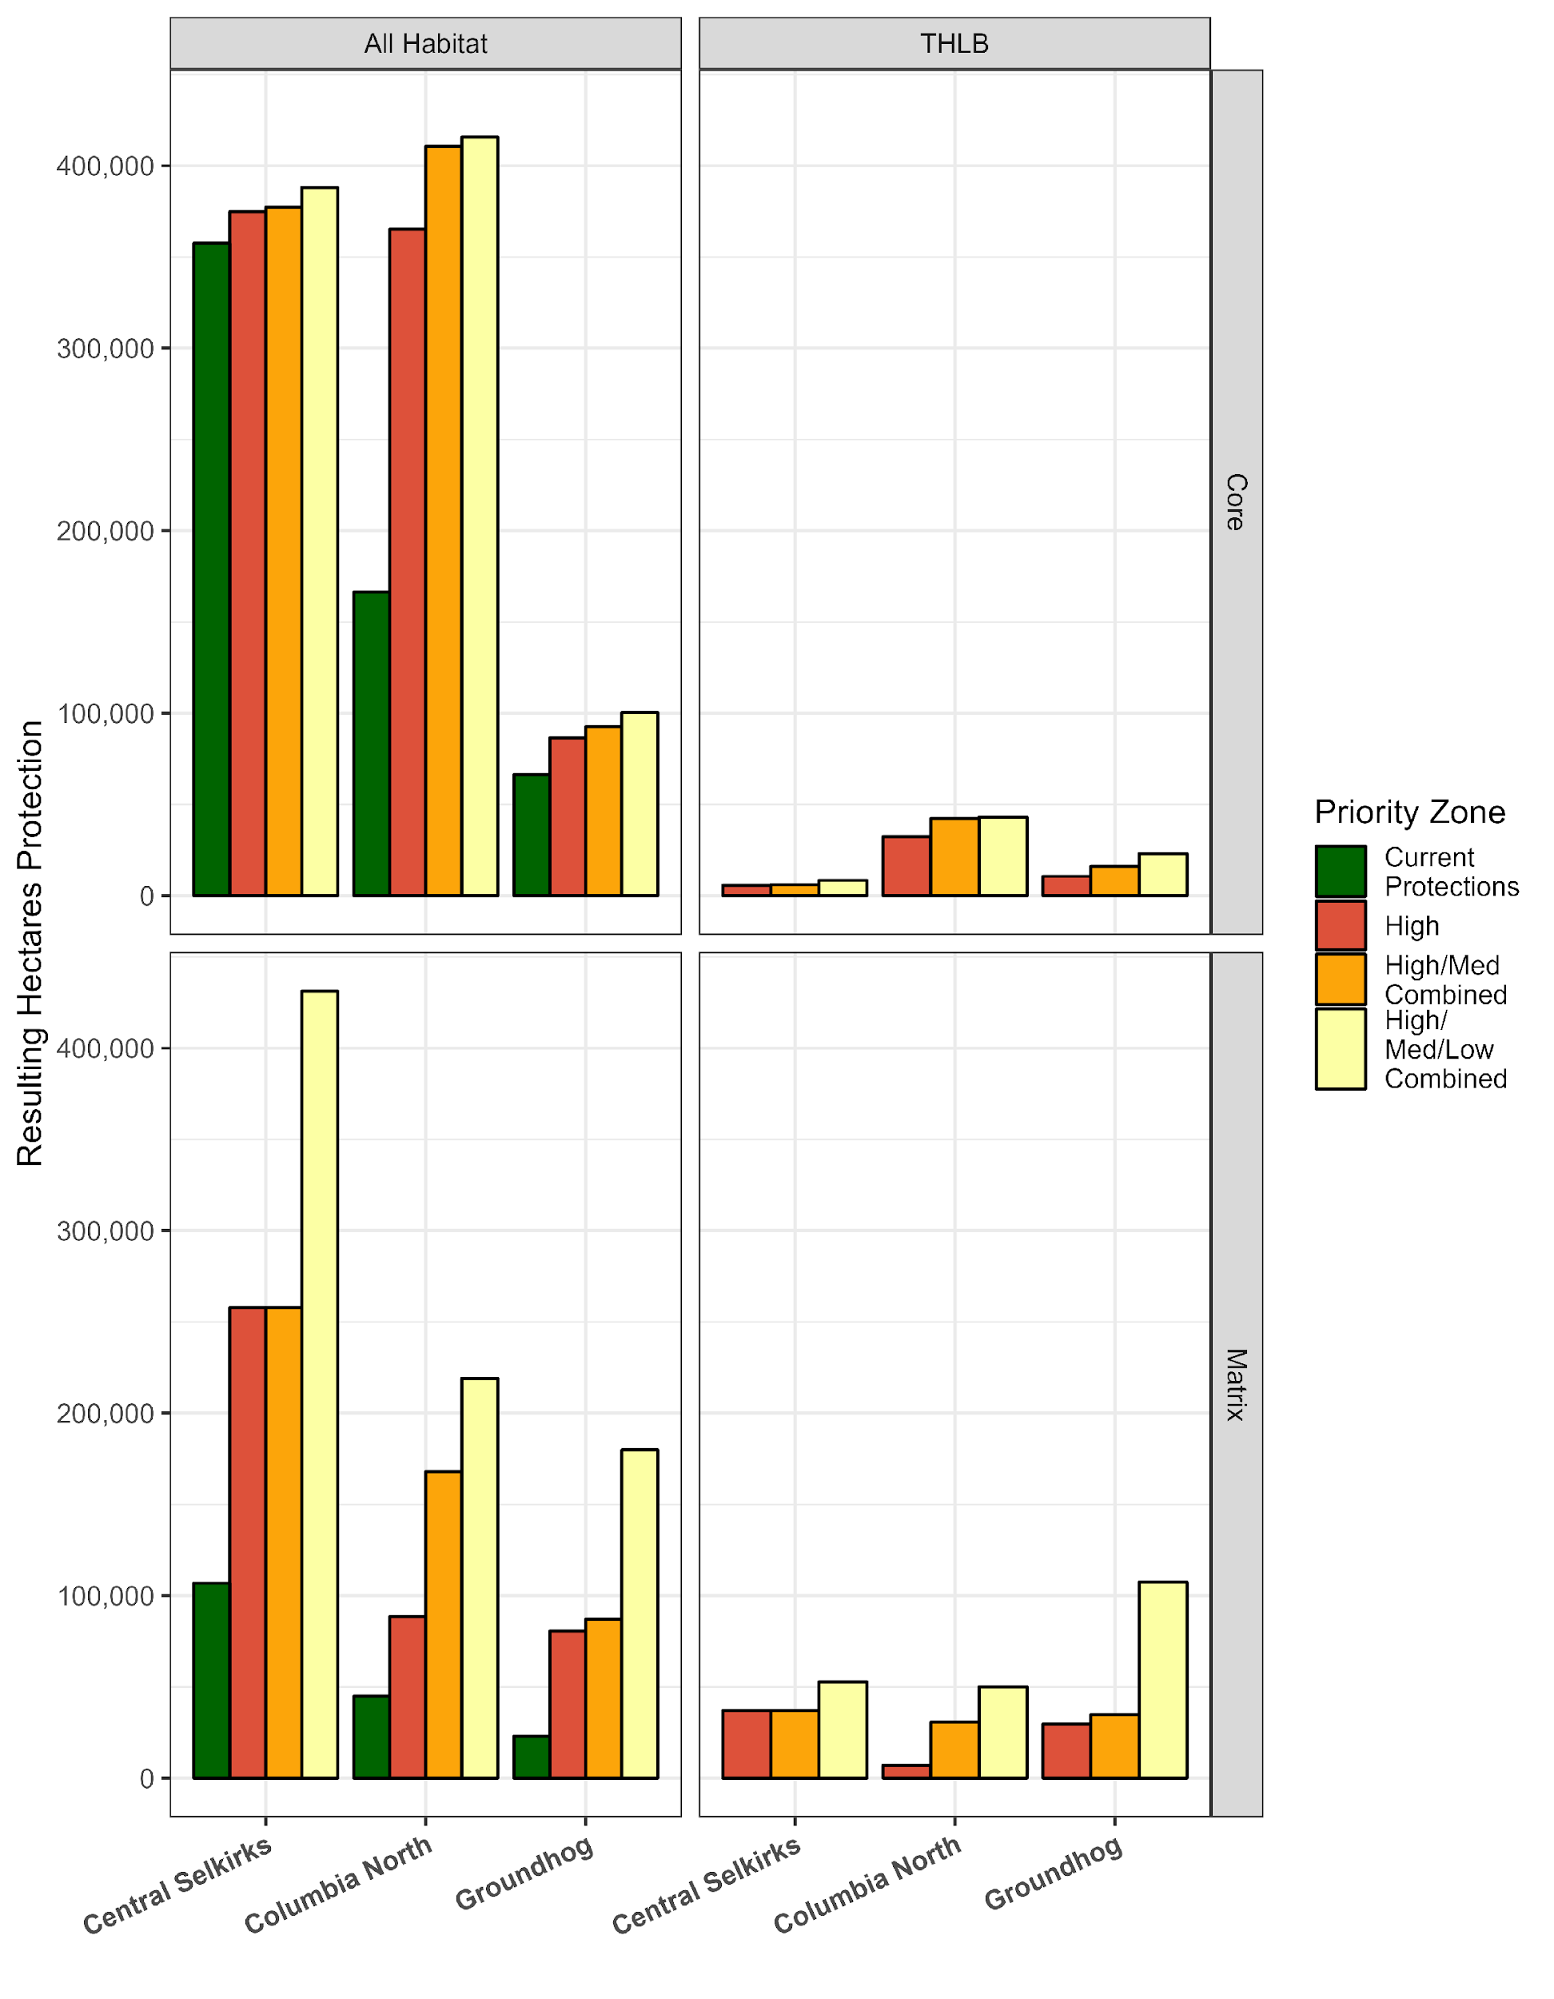
How options are defined – flow chart
Options are IN ADDITION to existing protections
Identify Core and Matrix Habitat
Exclude Existing Disturbances
Include Areas with Stand Age > 80 years
Exclude Areas > 70% slope
Assign Priority (SME or Kernel)
Calculate Resulting Protection and THLB Impact

Slide 42
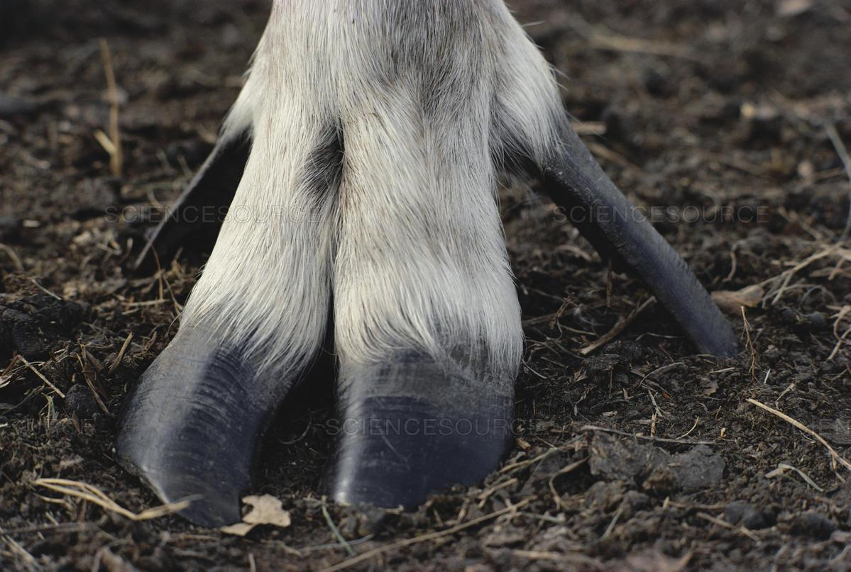
Why not Columbia South, Frisby Boulder, Central Rockies?
Prioritize habitat protection in areas where caribou currently are
Maximize conservation capital
3. Not losing GAR habitat protection

Slide 43

How can these options be improved?

Slide 44
Areas that are not going to be Core (e.g., Tier 3) what will happen to them?
Matrix management discussion
Tradeoffs between predator management and logging

Slide 45
References
BC Forest Analysis and Inventory Branch. 2021. “VRI - 2021 - Forest Vegetation Composite Polygons - Datasets - Data Catalogue.” https://catalogue.data.gov.bc.ca/dataset/vri-2021-forest-vegetation-composite-polygons.
Bergerud, A. T., and J. P. Elliott. 1998. “Wolf Predation in a Multiple-Ungulate System in Northern British Columbia.” Canadian Journal of Zoology 76 (8): 15511569.
Dickie, Melanie, Robert Serrouya, R. Scott McNay, and Stan Boutin. 2017. “Faster and Farther: Wolf Movement on Linear Features and Implications for Hunting Behaviour.” Journal of Applied Ecology 54 (1): 253–63. https://doi.org/10.1111/1365-2664.12732.
Dyer, S. J., J. P. O’Neill, S. M. Wasel, and S. Boutin. 2002. “Quantifying Barrier Effects of Roads and Seismic Lines on Movements of Female Woodland Caribou in Northeastern Alberta.” Canadian Journal of Zoology-Revue Canadienne De Zoologie 80 (May): 839–45. https://doi.org/10.1139/z02-060.
Dyer, Simon J., Jack P. O’Neill, Shawn M. Wasel, and Stan Boutin. 2001. “Avoidance of Industrial Development by Woodland Caribou.” The Journal of Wildlife Management, 531542.
Environment Canada. 2014. “Species at Risk Public Registry - Recovery Strategy for the Woodland Caribou, Southern Mountain population (Rangifer tarandus caribou) in Canada - 2014.” https://www.sararegistry.gc.ca/default.asp?lang=En&n=26702D59-1.
Johnson, Chris J, Katherine L Parker, Douglas C Heard, and Michael P Gillingham. 2002. “A Multiscale Behavioral Approach to Understanding the Movements of Woodland Caribou.” Gillingham Source: Ecological Applications Ecological Applications 12 (126): 18401860. http://www.jstor.org/stable/3099941 http://www.jstor.org/stable/3099941?seq=1&cid=pdf-reference#references_tab_contents http://about.jstor.org/terms.
Seip, Dale R. 1991. “Predation and Caribou Populations.” Rangifer, October, 46–52. https://doi.org/10.7557/2.11.4.993.
Teucher, Andy. 2018. “Land Designations That Contribute to Conservation in BC - Spatial Data - Spatial Data (Geopackage): Land Designations That Contribute to Conservation - Data Catalogue.” https://catalogue.data.gov.bc.ca/dataset/land-designations-that-contribute-to-conservation-in-bc-spatial-data/resource/5f2382cc-58c5-4063-84cd-a5938ca28def.
Weckworth, Byron V., Mark Hebblewhite, Stefano Mariani, and Marco Musiani. 2018. “Lines on a Map: Conservation Units, Meta-Population Dynamics, and Recovery of Woodland Caribou in Canada.” Ecosphere 9 (7): e02323.
Willems EP, Hill RA. Predator‐specific landscapes of fear and resource distribution: effects on spatial range use. Ecology. 2009 Feb;90(2):546-55.
Dyer, S. J., J. P. O’Neill, S. M. Wasel, and S. Boutin. 2002. “Quantifying Barrier Effects of Roads and Seismic Lines on Movements of Female Woodland Caribou in Northeastern Alberta.” Canadian Journal of Zoology-Revue Canadienne De Zoologie 80 (May): 839–45. https://doi.org/10.1139/z02-060.
Dyer, Simon J., Jack P. O’Neill, Shawn M. Wasel, and Stan Boutin. 2001. “Avoidance of Industrial Development by Woodland Caribou.” The Journal of Wildlife Management, 531542.

Slide 46
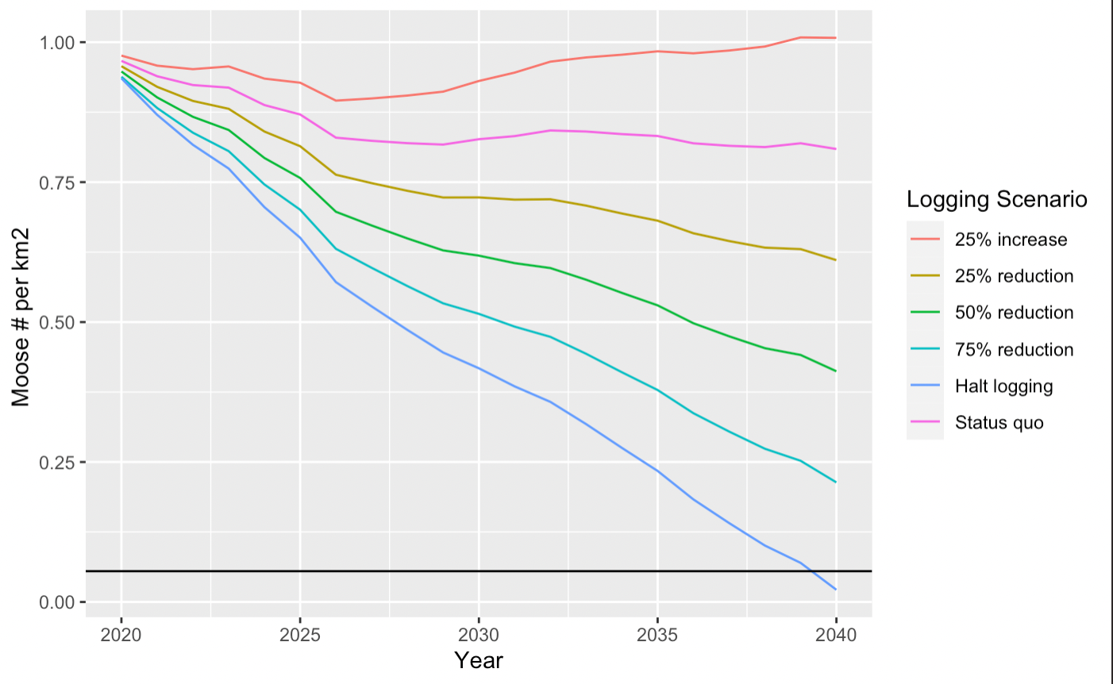

Appendix: Future scenarios of moose density (Columbia North herd boundary)
# of moose per km2
Threshold of moose density adequate for caribou recovery
610 hectares logged per year
Notes:
Explain things on the graph
LEGEND
Make Bigger
# of Moose per squm
Projected Moose carrying capacity (measured as # of moose per km2). Scenario 1: 0 hectares cut annually. Scenario 2: average forest harvesting, defined as the mean annual area cut between 2010-2019 (631 hectares annually). Scenario 3: 25% reduction of average forest harvesting. Scenario 4: 50% reduction of average forest harvesting. Scenario 5: 75% reduction of average forest harvesting. Scenario 6: 25% increase of average forest harvesting. This is for the Columbia North caribou population, in the Revelstoke Valley (Management Units 438,439)
Black line is the threshold of moose density (and therefore wolves) where caribou growth has been observed across multiple systems.

Slide 47
